Slide 1




Linear and Generalized Linear Models (4433LGLM6Y)
ANCOVA
Meeting 3
Dr. Jos Hageman

Slide 2

Analysis of covariance (ANCOVA)
ANCOVA is due to
R. A. Fisher.
It is described in his book “Statistical methods for research workers” in 1930 and improved in 1935.
First applied to increase precision by H. G. Sanders (advised by Fisher) in 1930.

Slide 3
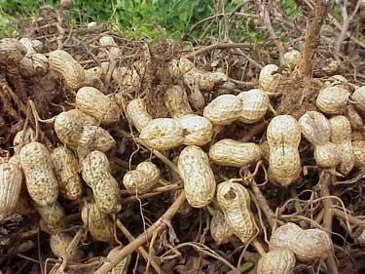
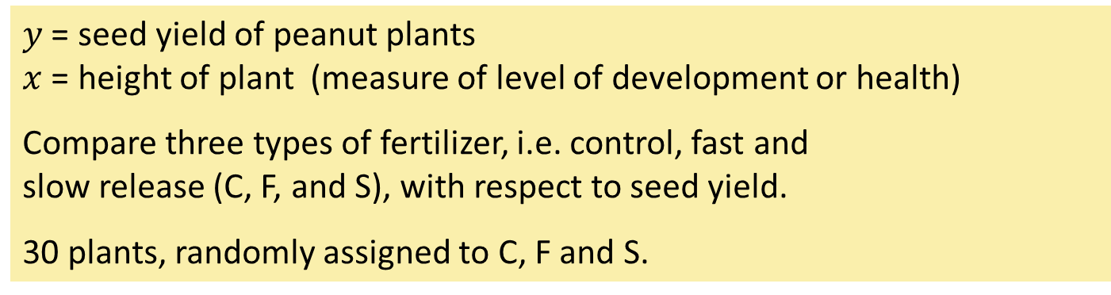
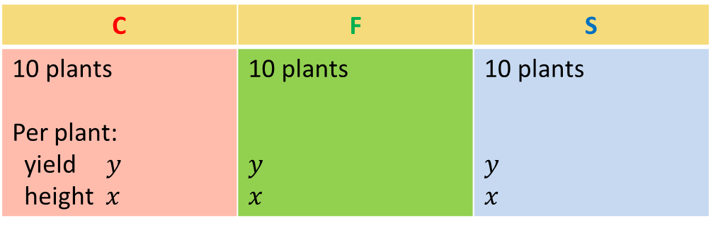
Example: Seed yield of peanut plants -1
$y$ = seed yield of peanut plants $x$ = height of plant (measure of level of development or health)
Compare three types of fertilizer, i.e. control, fast and slow release (C, F, and S), with respect to seed yield.
30 plants, randomly assigned to C, F and S.
C | F | S
10 plants Per plant: yield $y$ height $x$ | 10 plants $y$ $x$ | 10 plants $y$ $x$

Slide 4
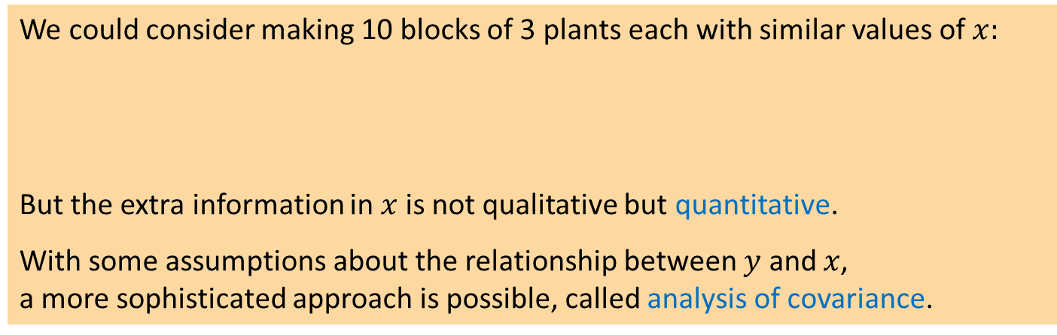
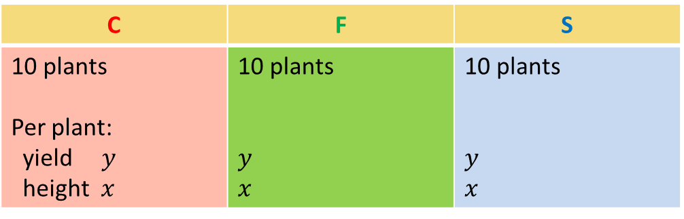
Example: Seed yield of peanut plants -2
C | F | S
10 plants Per plant: yield $y$ height $x$ | 10 plants $y$ $x$ | 10 plants $y$ $x$
We could consider making 10 blocks of 3 plants each with similar values of $x:$
But the extra information in $x$ is not qualitative but quantitative.
With some assumptions about the relationship between $y$ and $x$, a more sophisticated approach is possible, called analysis of covariance.
C F S | C F S | C F S | C F S | C F S | C F S | C F S | C F S | C F S | C F S

Slide 5
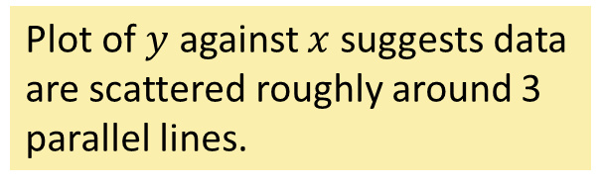
Seed yield of peanut plants
Fert x y
1 C 45 12.2
2 C 52 12.4
3 C 42 11.9
: : : :
10 C 33 11.4
11 S 63 16.6
12 S 50 15.8
: : : :
20 S 49 15.8
21 F 52 9.5
: : : :
28 F 67 10.3
29 F 55 9.5
30 F 40 8.5
Plot of $y$ against $x$suggests data are scattered roughly around 3 parallel lines.

Slide 6
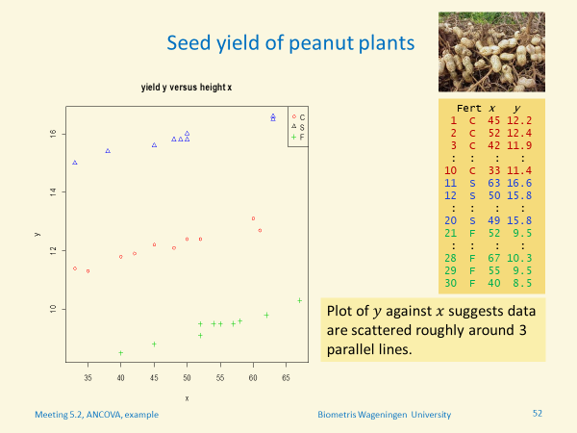

The relation between yield (y) and height of the plant is
A. a linear relation as seen in regression models Raise your right hand
B. an example of differences between populations as seen in ANOVA
models Raise your left hand

Slide 7
Peanut plants, one-way ANOVA (ignoring $x$)
> oneway.peanuts <- lm(y ~ Fert, data=peanuts)
> anova(oneway.peanuts)
Analysis of Variance Table
Response: y
Df Sum Sq Mean Sq F value Pr(>F)
Fert 2 207.683 103.841 394.28 < 2.2e-16
Residuals 27 7.111 0.263
Output from R
Note for later use: $SSE=7.11$ , ${\hat{σ}}_{ε}^{2 }$= MSE = 0.263
Notes:
Here we ignore the covariate x.
We will compare the results later on with ANCOVA, and show that the latter has higher precision.

Slide 8
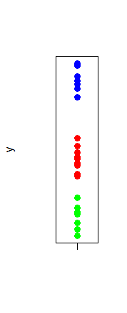
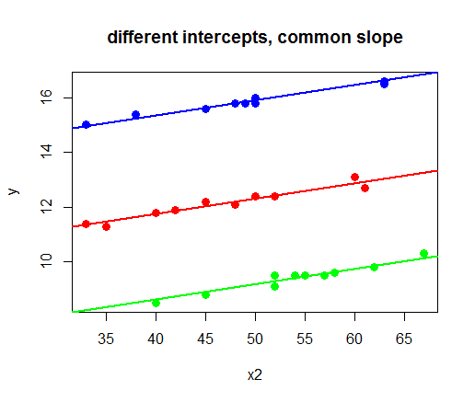

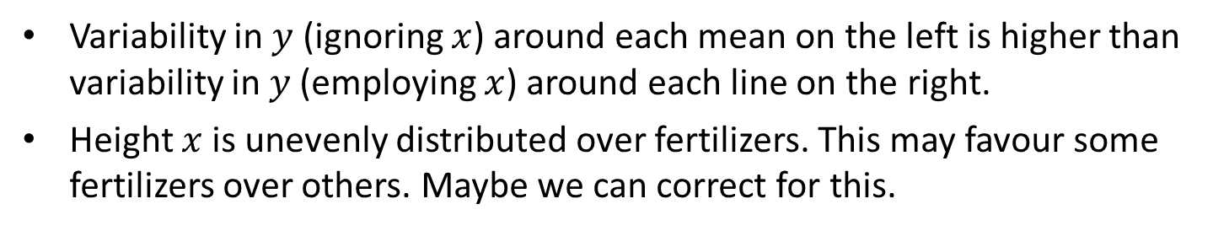

Motivation to include covariate $x$
C=standard
F=fast release
S=slow release
x
variability ignoring $x$
variability including $x$
Variability in $y$ (ignoring $x$) around each mean on the left is higher than variability in $y$ (employing $x$) around each line on the right.
Height $x$ is unevenly distributed over fertilizers. This may favour some fertilizers over others. Maybe we can correct for this.

Slide 9
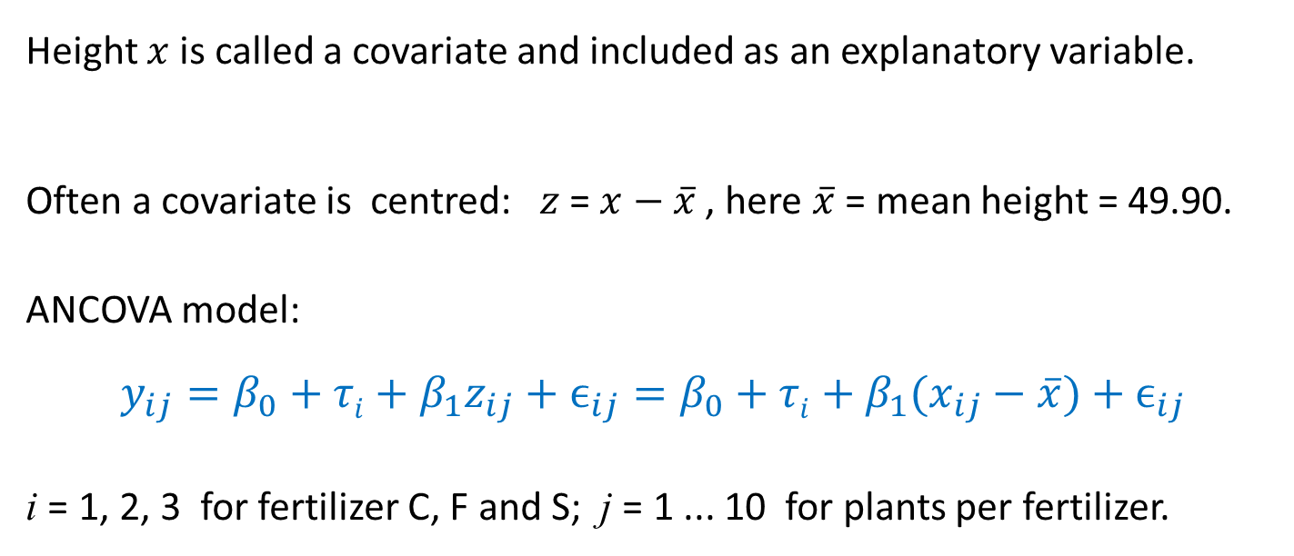
Analysis of Covariance (ANCOVA) model, peanut plants
Height $x$ is called a covariate and included as an explanatory variable. Often a covariate is centred:$z$ = $x−\overline{x}$ , here $\overline{x}$ = mean height = 49.90.
ANCOVA model:
$$y_{ij}=β_{0}+τi+β_{1}z_{ij}+ϵ_{ij}=β_{0}+τi+β_{1}(x_{ij}−\overline{x})+ϵ_{ij}$$ i = 1, 2, 3 for fertilizer C, F and S; j = 1 ... 10 for plants per fertilizer.

Slide 10


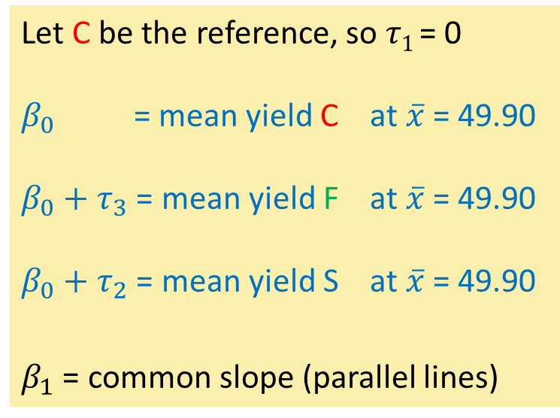




Analysis of Covariance (ANCOVA) model, peanut plants
$$y_{ij}=β_{0}+τi+β_{1}z_{ij}+ϵ_{ij}=β_{0}+τi+β_{1}(x_{ij}−\overline{x})+ϵ_{ij}$$
Let C be the reference, so $τ1$= 0
$β_{0}$ = mean yield C at $\overline{x}$ = 49.90
$β_{0}+τ_{3}$ = mean yield F at $\overline{x}$ = 49.90
$β_{0}+τ_{2}$ = mean yield S at $\overline{x}$ = 49.90
$β_{1}$ = common slope (parallel lines)
S
$$β_{1}$$
$$τ_{3}$$
$$β_{1}$$
C
$$β_{0}$$
$$τ_{2}$$
F
$$β_{1}$$
x

Slide 11

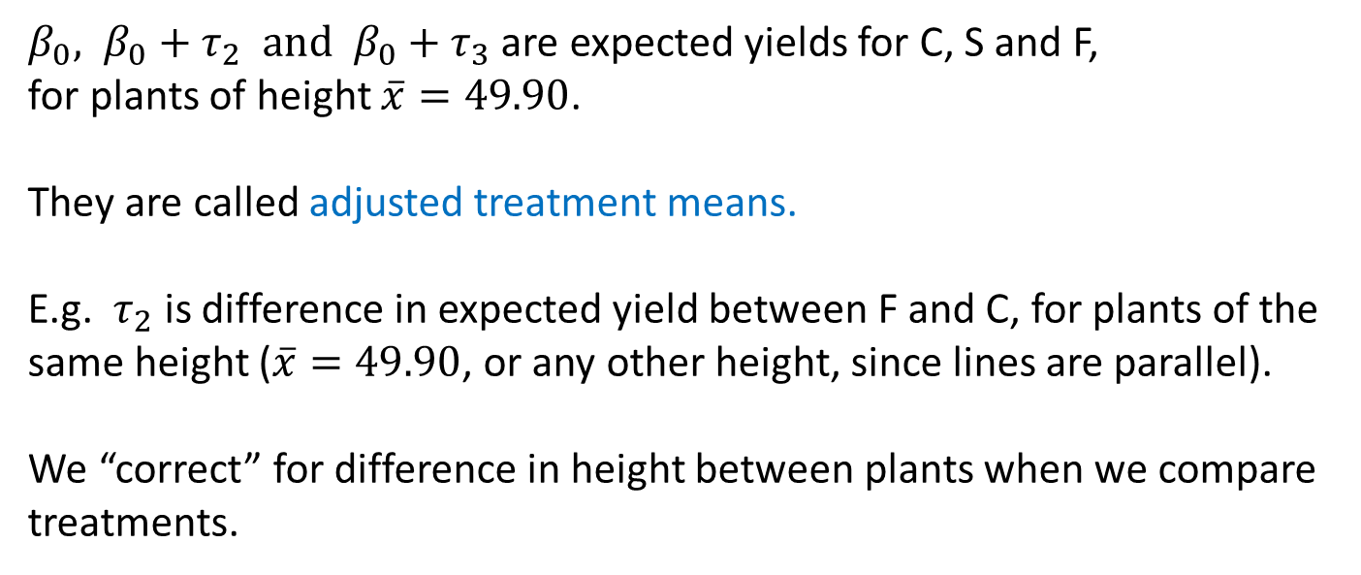
Adjusted treatment means, peanut plants
$$y_{ij}=β_{0}+τi+β_{1}z_{ij}+ϵ_{ij}=β_{0}+τi+β_{1}(x_{ij}−\overline{x})+ϵ_{ij}$$
${β_{0}, β}_{0}+τ_{2} and β_{0}+τ_{3}$ are expected yields for C, S and F, for plants of height $\overline{x}=49.90$.
They are called adjusted treatment means.
E.g. $τ_{2}$ is difference in expected yield between F and C, for plants of the same height ($\overline{x}=49.90$, or any other height, since lines are parallel).
We “correct” for difference in height between plants when we compare treatments.
Notes:
Show on the black board that distance between lines is the same for any value of x.
Briefly indicate that non-parallel lines are more complicated, because difference between treatments depends on value of x.

Slide 12
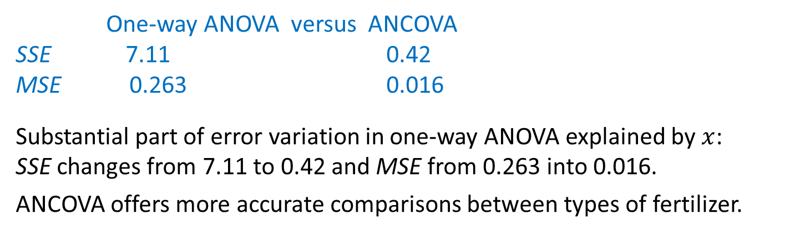
ANCOVA versus one-way ANOVA, peanut plants
R output
> z <- peanuts$x-mean(peanuts$x)
> ancova.peanuts <- lm(y ~ z + Fert, data=peanuts)
> anova(ancova.peanuts)
Analysis of Variance Table
Response: y
Df Sum Sq Mean Sq F value Pr(>F)
z 1 0.4722 0.4722 29.39 1.11e-05
Fert 2 213.9038 106.952 6657.08 2.22e-16
Residuals 26 0.4177 0.016
One-way ANOVA versus ANCOVA
SSE 7.11 0.42
MSE 0.263 0.016
Substantial part of error variation in one-way ANOVA explained by $x$: SSE changes from 7.11 to 0.42 and MSE from 0.263 into 0.016.
ANCOVA offers more accurate comparisons between types of fertilizer.
Notes:
Remark that 0.263 is an estimate around the each of the separte means, while 0.016 is an estimate around each of the parallel lines, as shown before.

Slide 13
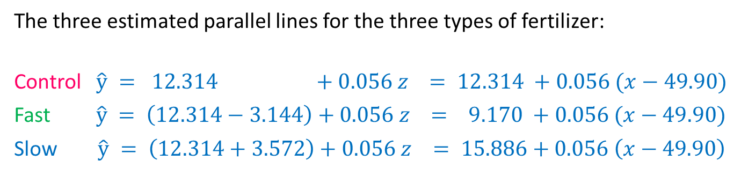
Three parallel lines, peanut plants
R output
> coef(summary(ancova.peanuts))
Estimate Std. Error t value Pr(>|t|)
(Intcpt) 12.314 0.04109 299.7 1.54e-47
z 0.056 0.00273 20.4 1.58e-17
FertF -3.144 0.06037 -52.1 7.94e-28
FertS 3.572 0.05703 62.6 6.82e-30
The three estimated parallel lines for the three types of fertilizer:
Control $\hat{y} = 12.314 +0.056 z = 12.314 +0.056 (x−49.90)$
Fast $\hat{y} = \left(12.314−3.144\right)+0.056 z = 9.170 +0.056 (x−49.90)$
Slow $\hat{y} = \left(12.314+3.572\right)+0.056 z = 15.886+0.056 \left(x−49.90\right)$
Notes:
Show on the black board that distance between lines is the same for any value of x.
Briefly indicate that non-parallel lines are more complicated, because difference between treatments depends on value of x.

Slide 14
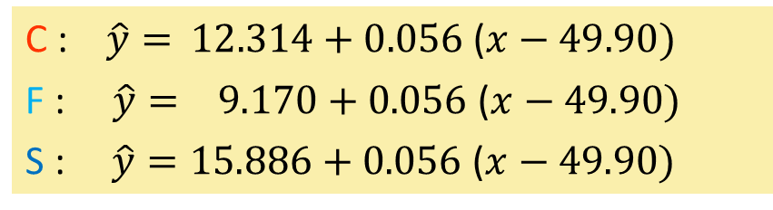
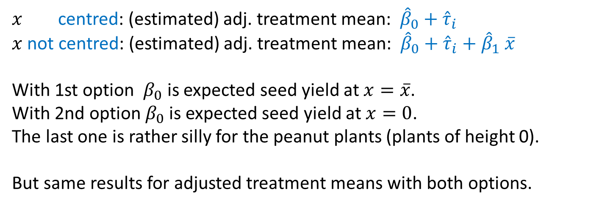
To centre or not to centre?
C : $\hat{y}=$ $12.314+0.056$($x−49.90)$
F : $\hat{y}= 9.170+0.056$ ($x−49.90)$
S : $\hat{y}=15.886+0.056$ ($x−49.90)$
$x$ centred: (estimated) adj. treatment mean: ${\hat{β}}_{0}+{\hat{τ}}_{i}$
$x$ not centred: (estimated) adj. treatment mean: ${\hat{β}}_{0}+{\hat{τ}}_{i}{+ \hat{β}}_{1}\overline{x}$
With 1st option $β_{0}$ is expected seed yield at $x=\overline{x}$.
With 2nd option $β_{0}$ is expected seed yield at $x=0$.
The last one is rather silly for the peanut plants (plants of height 0).
But same results for adjusted treatment means with both options.
Notes:
Stress that the estimated tau’s with the two options are the same, but the estimated intercepts are not.
They have a different meaning; referring to plant of height 49.90 and height 0 respectively.

Slide 15

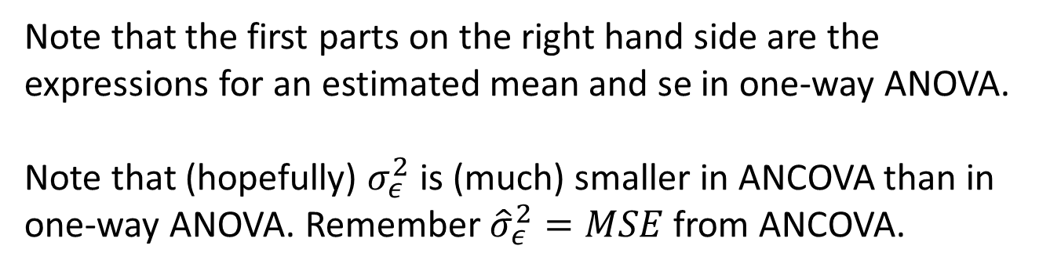
Adjusted treatment mean & standard error
=
ˆ
.
−
β
adj
mean
y
(
x
−
x
)
i
.
1
i
.
..
$$\hat{σ}$$
2
=
ε
+
−
ˆ
(
2
β
2
estimated
se
x
x
)
(
)
se
i
n
.
..
1
i
Note that the first parts on the right hand side are the expressions for an estimated mean and se in one-way ANOVA.
Note that (hopefully) $σ_{ε}^{2}$ is (much) smaller in ANCOVA than in one-way ANOVA. Remember ${\hat{σ}}_{ε}^{2}=MSE$ from ANCOVA.

Slide 16

Difference between adjusted treatment means & standard error
Difference between e.g. adj. means for treatments 1 and 2:
−
−
ˆ
y
y
β
(
x
−
x
)
1
.
2
.
1
1
.
2
.
⎛
1
1
⎞
=
⎜
+
+
−
ˆ
2
(
2
β
2
estimated
se
x
x
)
(
)
$$\hat{σ}$$
⎜
|
se
ε
1
.
2
⎝
n
n
⎠
.
1
1
2
Again, first parts on the right hand sides are the expressions for a difference and se in one-way ANOVA.

Slide 17

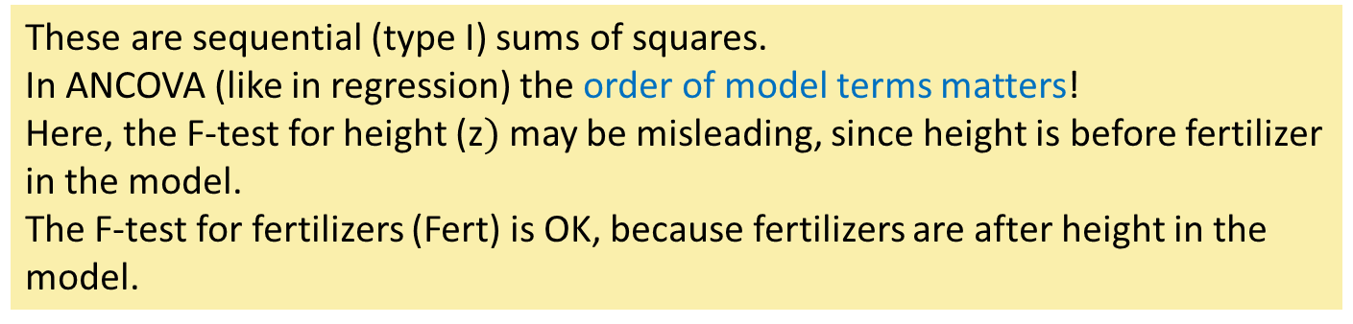
F-tests, R
> z <- peanuts$x-mean(peanuts$x)
> ancova.peanuts <- lm(y ~ z + Fert, data=peanuts)
> anova(ancova.peanuts)
Analysis of Variance Table
Response: y
Df Sum Sq Mean Sq F value Pr(>F)
z 1 0.4722 0.4722 29.39 1.11e-05
Fert 2 213.9038 106.952 6657.08 2.22e-16
Residuals 26 0.4177 0.016
These are sequential (type I) sums of squares.
In ANCOVA (like in regression) the order of model terms matters!
Here, the F-test for height (z$)$ may be misleading, since height is before fertilizer in the model.
The F-test for fertilizers (Fert) is OK, because fertilizers are after height in the model.

Slide 18
Adjusted treatment means, R
> coef(summary(ancova.peanuts))
Estimate Std. Error t value Pr(>|t|)
(Intcpt) 12.314 0.04109 299.7 1.54e-47
z 0.056 0.00273 20.4 1.58e-17
FertF -3.144 0.06037 -52.1 7.94e-28
FertS 3.572 0.05703 62.6 6.82e-30
Here, C is the reference.
Adjusted treatment means are:
C: 12.31 ‘Intcpt’
F: 12.314 - 3.144 = 9.17 ‘Intcpt’ + ‘FertF’
S: 12.314 + 3.572 = 15.89 ‘Intcpt’ + ’FertS’

Slide 19




Pairwise comparisons between adjusted treatment means, R
> library(emmeans)
> lsm <- emmeans(ancova.peanuts, pairwise ~ Fert)
> summary(lsm, adjust="none")
$lsmeans
Fert lsmean SE df lower.CL upper.CL
C 12.31 0.0411 26 12.23 12.40
F 9.17 0.0418 26 9.08 9.26
S 15.89 0.0402 26 15.80 15.97
Confidence level used: 0.95
$contrasts
contrast estimate SE df t.ratio p.value
C - F 3.14 0.0604 26 52.1 <.0001
C - S -3.57 0.0570 26 -62.6 <.0001
F - S -6.72 0.0585 26 -114.8 <.0001
$$−6.72$$
$$−3.57$$
$$3.14$$
x
This is Fisher’s LSD method:
adjust = “none”

Slide 20



How does the correction work out?
↑
$$y$$
line 1
line 2
….
difference
between adj. means
without shifting the data along the lines, there is hardly any difference between treatments 1 and 2
data treatment 1
data treatment 2
….
$x$ →
mean ${\overline{x}}_{..}$
Notes:
Clarify that treatment 1 is at a disadvantage (small values for x) and treatment 2 is at an advantage (large values for x). This distorts the impression about the difference between the treatments. After correction for x, giving a fair comparison, a treatment difference shows up.

Slide 21
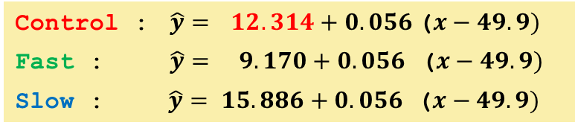
Ordinary & adjusted treatment means
adjusted means
Control : $\hat{y}=$ $12.314+0.056$($x−49.9)$
Fast : $\hat{y}= 9.170+0.056$ ($x−49.9)$
Slow : $\hat{y}= 15.886+0.056$ ($x−49.9)$
y.length y.mean yield y
Control 10 12.13
Fast 10 9.41
Slow 10 15.83
x.length x.mean height x
Control 10 46.6
Fast 10 54.2
Slow 10 48.9
sample means
Why is the adjusted mean for C (= 12.314) higher than the sample mean (= 12.13)?
Notes:
This is because average length for C (46.6) was lower than overall average length (49.9). So, on average C had relatively low plants. So, after correction for height, the mean (now the adjusted mean) will go up.

Slide 22
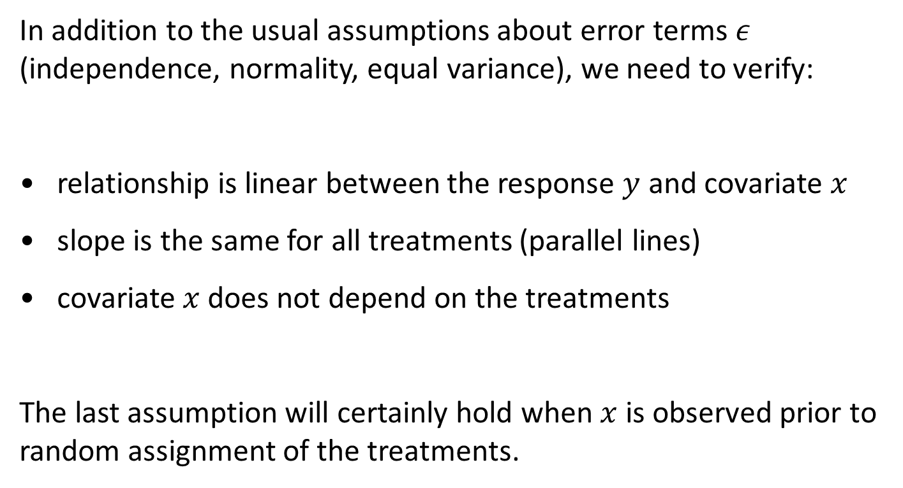
Assumptions in ANCOVA
In addition to the usual assumptions about error terms $ε$ (independence, normality, equal variance), we need to verify:
relationship is linear between the response $y$ and covariate $x$
slope is the same for all treatments (parallel lines)
covariate $x$ does not depend on the treatments
The last assumption will certainly hold when $x$ is observed prior to random assignment of the treatments.
Any idea
about how we can test this?

Slide 23

Test for non-parallel lines
Test whether lines are parallel by including extra interaction terms between factor and covariate,
e.g. interaction between fertilizer and height for peanut plants will give three lines with separate intercepts and separate slopes.
Compare with an F-test:
Complete model (= model with interaction):
separate slope and separate intercept for each fertilizer, so three arbitrary lines
Reduced model (= analysis of covariance model):
common slope and separate intercept for each fertilizer, so three parallel lines

Slide 24
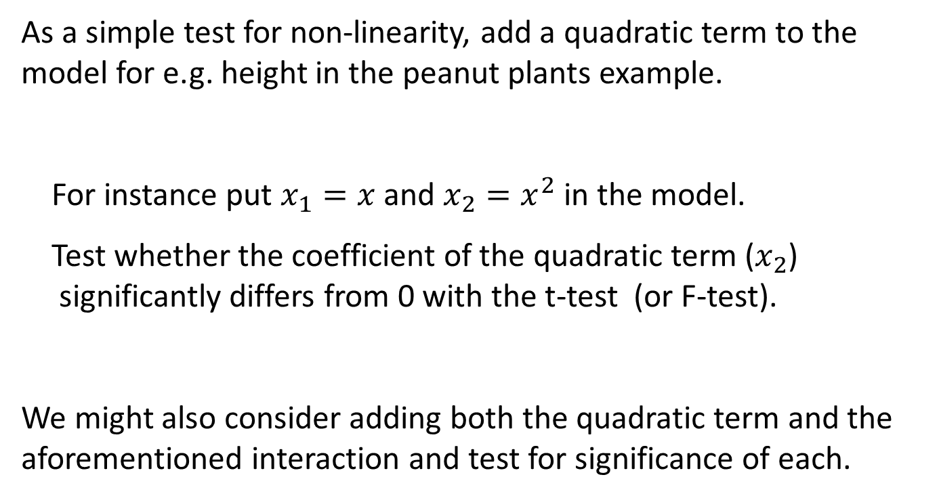
Test for non-linearity
As a simple test for non-linearity, add a quadratic term to the model for e.g. height in the peanut plants example.
For instance put $x_{1}=x$ and $x_{2}=x^{2}$ in the model.
Test whether the coefficient of the quadratic term ($x_{2}$) significantly differs from 0 with the t-test (or F-test).
We might also consider adding both the quadratic term and the aforementioned interaction and test for significance of each.

Slide 25

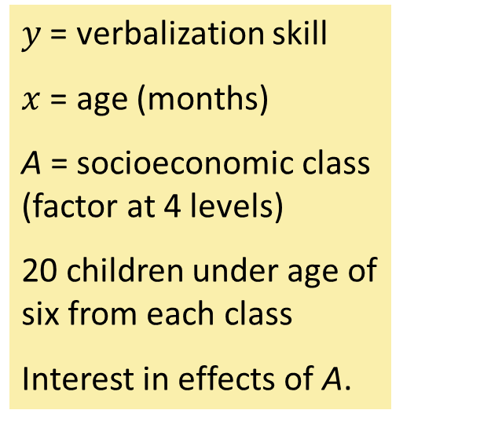
Another example: verbalization skills
$y$ = verbalization skill
$x$ = age (months)
A = socioeconomic class (factor at 4 levels)
20 children under age of six from each class
Interest in effects of A.
Notes:
More realistic example; plot looks more messy.

Slide 26
Verbalization skills, parallel lines?
Analysis of Variance Table
Response: vs
Df Sum Sq Mean Sq F value Pr(>F)
fclass 3 5269.6 1756.53 37.3221 1.16e-14
age 1 731.3 731.32 15.5388 0.0001853
fclass:age 3 185.9 61.97 1.3167 0.2756080
Residuals 72 3388.6 47.06
Check for parallel lines: P-value for interaction = 0.28 > 0.05.
Omit interaction and adopt additive ANCOVA model.
This is the model with parallel lines.

Slide 27
Verbalisation skills, linear relationship?
Check by adding the square of the scaled covariate z.
agecent is centred age
agecent2 is its square
Coefficients:
Estimate Std. Error t value Pr(>|t|)
(Intercept) 22.087998 1.662620 13.285 < 2e-16
agecent 0.147946 0.099430 1.488 0.141018
agecent2 0.009872 0.005014 1.969 0.052705
fclass2 5.835949 2.152520 2.711 0.008329
fclass3 7.473394 2.163661 3.454 0.000917
fclass4 22.387407 2.176442 10.286 6.47e-16
Near indication for curvature (P-value = 0.053). We will ignore it here, but it may warrant further attention.

Slide 28
Testing, verbalization skills,
Anova Table (Type II tests)
Response: vs
Sum Sq Df F value Pr(>F)
age 731.3 1 15.344 0.000196
fclass 5051.8 3 35.332 2.42e-14
Residuals 3574.5 75
Type II SS (obtained with routine ‘Anova’ from ‘car’ library) , so OK.
Covariate age adds significantly to the model (P-value = 0.000...).
Significant differences among socio economic classes (P-value = 0.000196).

Slide 29
Adjusted means & pairwise comparisons, verbalization skills
$`emmeans`
fclass emmean SE df lower.CL upper.CL
1 23.4 1.55 75 20.4 26.5
2 29.7 1.54 75 26.6 32.7
3 30.3 1.54 75 27.3 33.4
4 45.1 1.54 75 42.0 48.2
Confidence level used: 0.95
$contrasts
contrast estimate SE df t.ratio p.value
1 - 2 -6.228 2.18 75 -2.852 0.0056
1 - 3 -6.904 2.19 75 -3.160 0.0023
1 - 4 -21.671 2.19 75 -9.911 <.0001
2 - 3 -0.676 2.18 75 -0.310 0.7576
2 - 4 -15.443 2.18 75 -7.071 <.0001
3 - 4 -14.767 2.18 75 -6.763 <.0001
Multiple testing with Fisher’s LSD

Slide 30
Relative efficiency, verbalization skills
Is it worthwhile to include the covariate?
This is one-way ANOVA versus ANCOVA.
Rough and ready approach, comparing MSEs:
RE = MSE(one-way ANOVA) / MSE(ANCOVA) = 56.66 / 47.06 = 1.2
Analysis of Variance Table
Response: vs
Df Sum Sq Mean Sq F value Pr(>F)
fclass 3 5269.6 1756.53 31.003 3.401e-13
Residuals 76 4305.8 56.66
output from one-way ANOVA

Slide 31
Should correction for covariate be made at all?
Correction for covariate may unwittingly remove (part of) treatment effects, when covariate is influenced by treatment.
Correction for covariate may erroneously rely on extrapolation of regression lines, when covariate values are very different between groups due to poor study design or unfortunate configuration in observational study; there should be sufficient overlap.
Correction for covariate may create unrealistic adjusted means for some groups, when covariate values differ systematically between groups in the underlying population.
E.g. comparing males and females, do not correct to common value for (initial) body weight.
Notes:
Draw picture of two parallel curves (with clear curvature), one treatments with x-values on the left and the other on the right.
Lines as linear approximations within the two disjoint ranges. Show that extrapolation with the lines may differ quite a lot from the true curves.

Slide 32

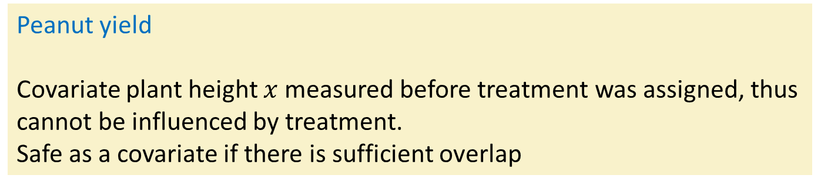
The examples - 1
Peanut yield
Covariate plant height $x$measured before treatment was assigned, thus cannot be influenced by treatment.
Safe as a covariate if there is sufficient overlap
Question
what if $x$was measured a week after start of the experiment?
Answer
Plant height will likely be influenced by treatment.
Correction for plant height would remove part of the treatment effect on peanut yield.
Do not use this measure of height as a covariate.

Slide 33
The examples - 2
Verbalization skill of children
Covariate age is not influenced by social class.
Safe as a covariate if there is sufficient overlap
Question
what if age was not measured at the start of the study, but at the end?
Answer
Age of a child is, of course, not influenced by social class.
Irrelevant when age is measured, as long as it is measured at the same moment for all children.
So, age at the end may be used as covariate.

Slide 34
Generally, do not use potential covariate when:
covariate is influenced by treatment (part of treatment effects will be removed)
covariate values have little overlap between treatments (tricky linear extrapolation of regression lines)
covariate differs systematically between treatments in the population (leads to unrealistic adjusted means)

